Slide 1


STRUCTURAL
DESIGN PATTERNS
Burak Atalay
02.12.2024

Slide 2
OVERVIEW
01
Introduction
05
Flyweight
02
Adapter
06
Composite
03
Bridge
07
Facade
04
Decorator
08
Proxy
01

Slide 3
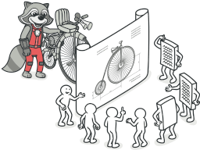
INTRODUCTION
Design patterns are solutions to commonly occurring problems in software design.
The pattern is not a specific piece of code, but a general concept that you can apply it in your software
Structural patterns explains how to assemble objects and classes into larger structures by using composition, while keeping these structures flexible and efficient
02

Slide 4
ADAPTER
03

Slide 5
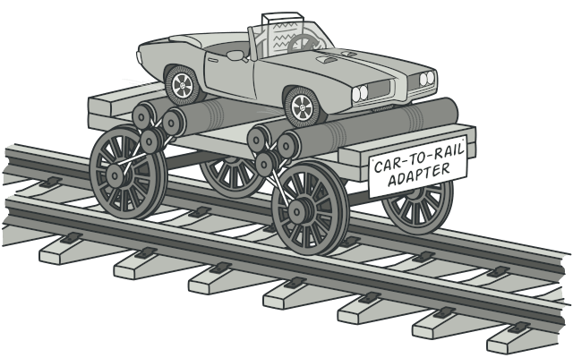
It allows objects with incompatible interfaces to collaborate
As the name suggests, it acts as an intermediary to convert an otherwise incompatible interface to one that a client expects
04

Slide 6
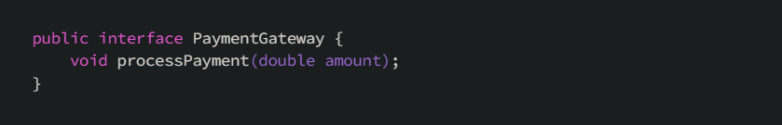
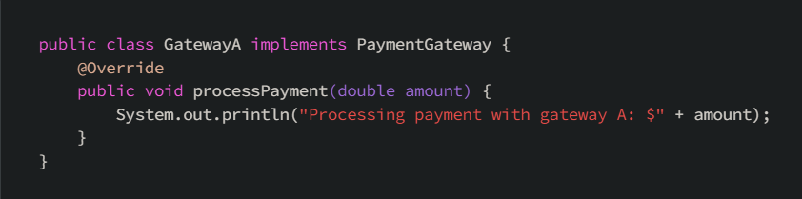
Suppose you have a Retail or E-commerce system that has different payment gateways and you have implemented your first gateway (GatewayA) by implementing an interface
05

Slide 7
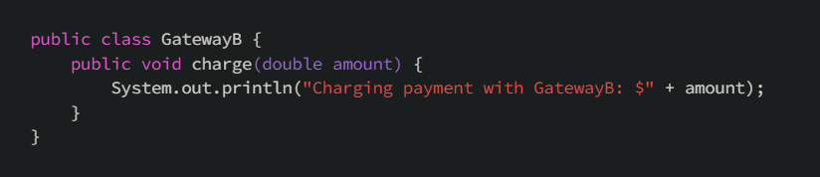
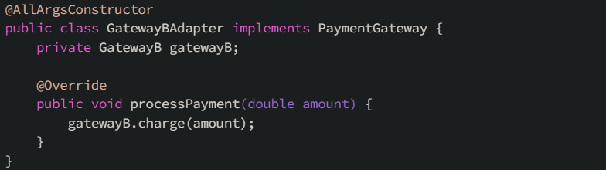
Now imagine you want to add another gateway which has a different implementation. You want to make your second gateway work with the old interface you defined before so you create an adapter which implements the interface.
06

Slide 8
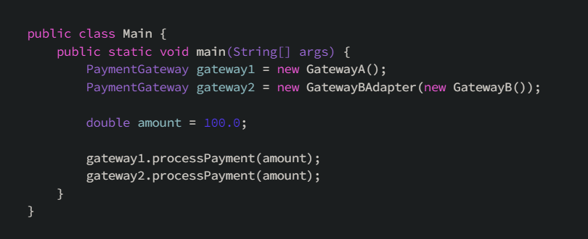
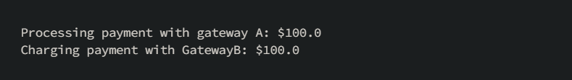
07

Slide 9
BRIDGE
08

Slide 10
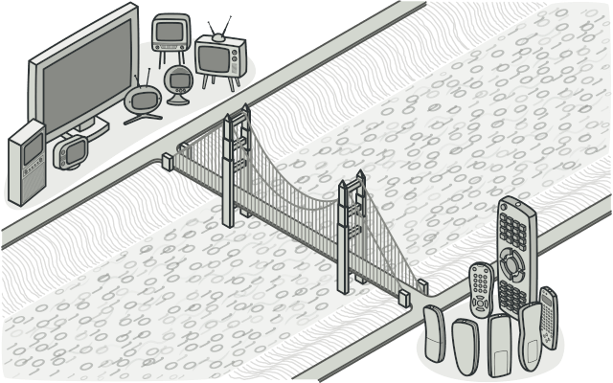
The Bridge pattern is a structural pattern that decouples an abstraction from its implementation, allowing them to vary independently but still have a way, or bridge, to interact
09

Slide 11
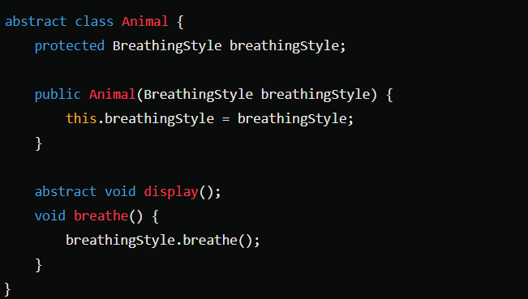

In this code example, Animal will be Abstraction part of the Bridge pattern while BreathingStyle will be Implementor part.
Animal abstract class will store the reference of the BreathingStyle interface and subclasses of Animal class can do breathing by using this reference.
10

Slide 12
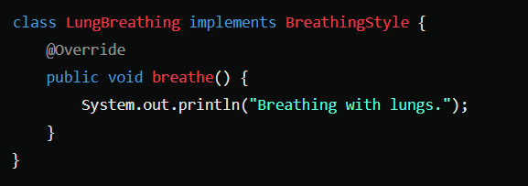
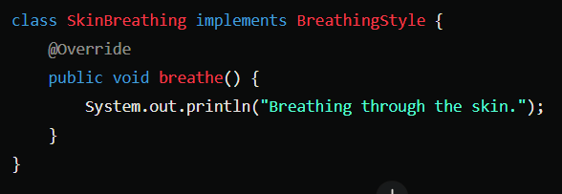
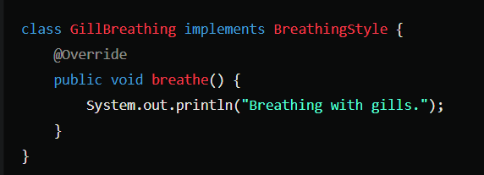
11

Slide 13
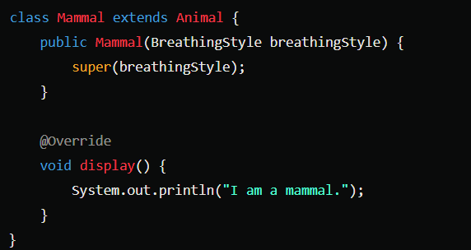
12

Slide 14
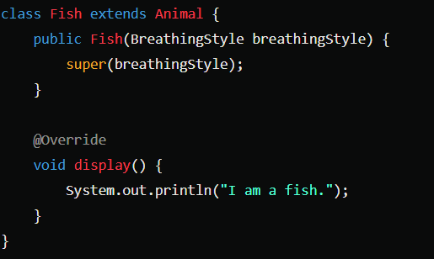
13

Slide 15
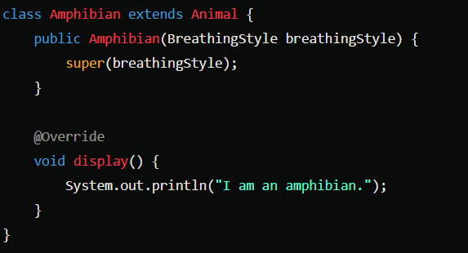
14

Slide 16
DECORATOR
15

Slide 17
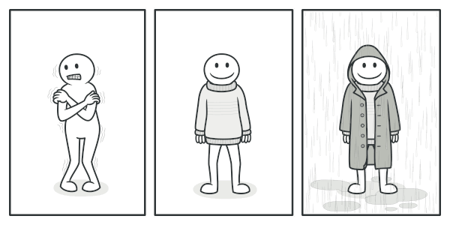
Allows for dynamically adding or modifying behaviors of objects at runtime by wrapping them with decorator objects
Instead of relying on a fixed inheritance hierarchy, the Decorator pattern uses composition. It enables combining objects to extend their functionality without altering the object's class
16

Slide 18

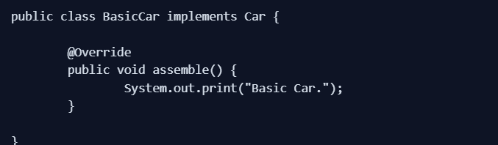
17

Slide 19
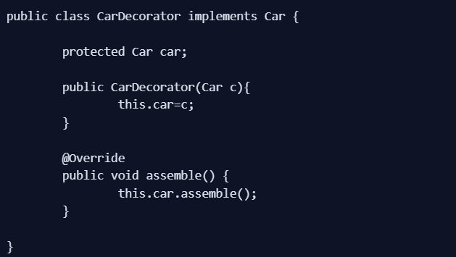
18

Slide 20
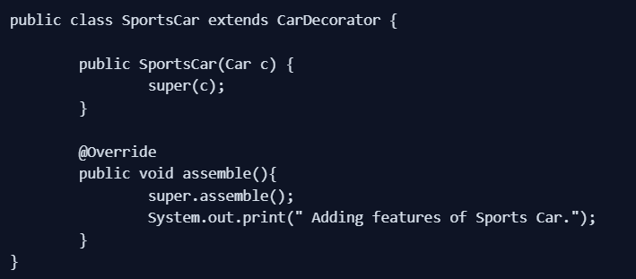
19

Slide 21
FLYWEIGHT
20

Slide 22
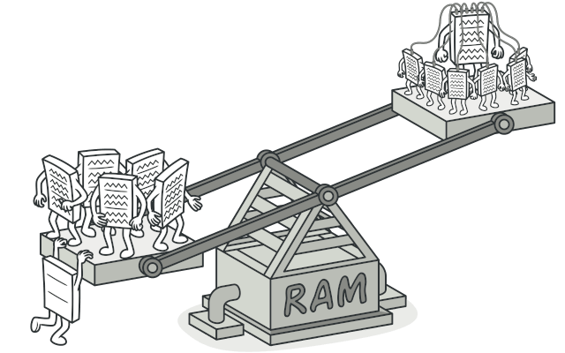
Aims to minimize the memory usage and improve the performance of an application by sharing the common data between objects instead of creating a new object of the common data for each object
21

Slide 23
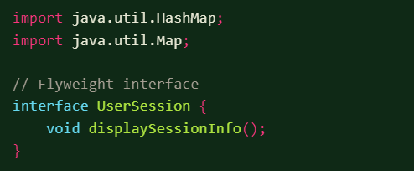
This code example is about managing user sessions efficiently with help from Flyweight pattern.
Instead of creating the common session information for each user, a factory class will pass the reference of the common information to the each user.
22

Slide 24
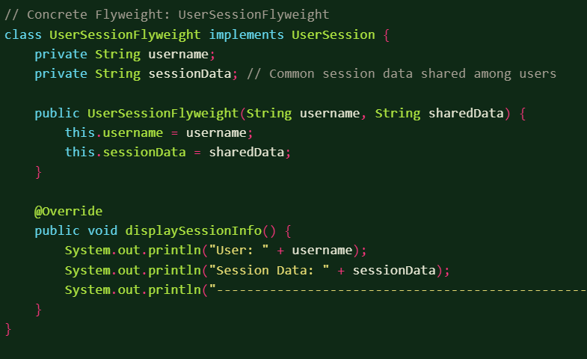
23

Slide 25
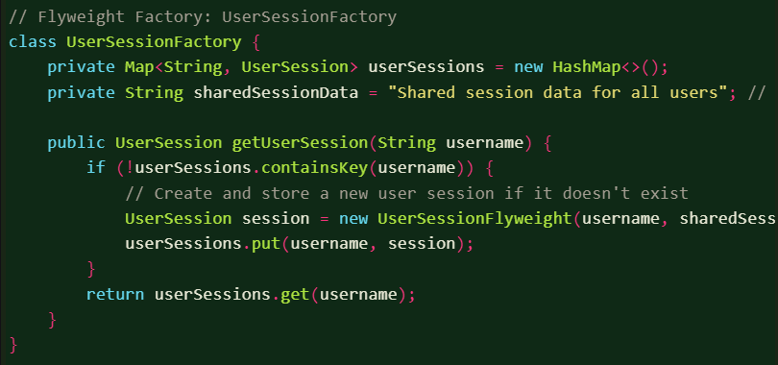
24

Slide 26
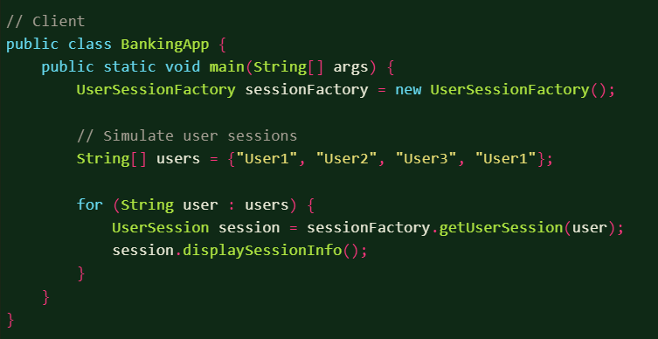
25

Slide 27
COMPOSITE
26

Slide 28
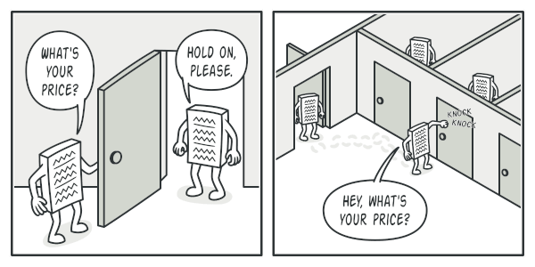
The Composite Pattern lets you compose objects into tree structures to represent part-whole hierarchies. It allows clients to treat individual objects and compositions of objects uniformly.
27

Slide 29
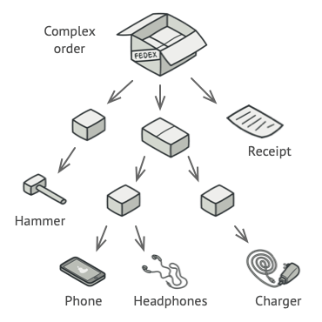
component -> is the base interface for all the objects in the composition.
leaf -> implements the default behavior of the base component. It doesn’t contain a reference to the other objects.
composite -> has leaf elements. It implements the base component methods and defines the child-related operations.
client -> has access to the composition elements by using the base component object.
28

Slide 30
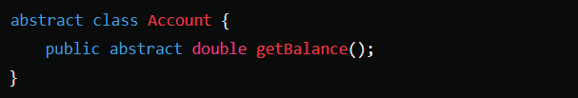
This toy example for the Composite pattern is about managing all the bank accounts of a user easily. Account abstract class will be the Component, different account types that inherits from Account will be the Leafs and Portfolio class will be the Composite.
29

Slide 31
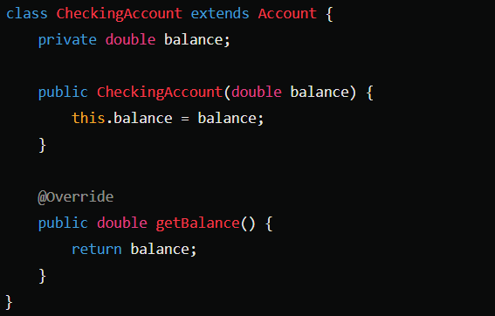
30

Slide 32
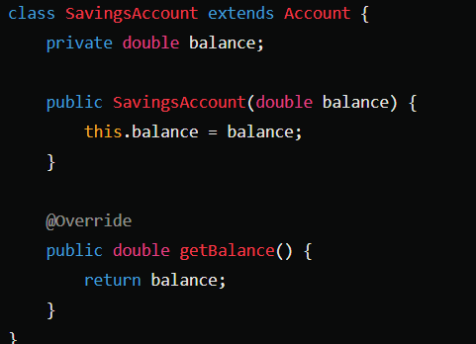
31

Slide 33
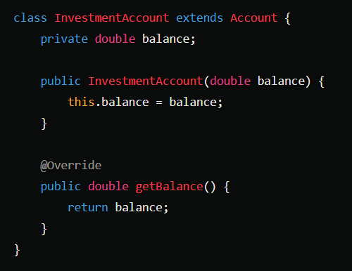
32

Slide 34
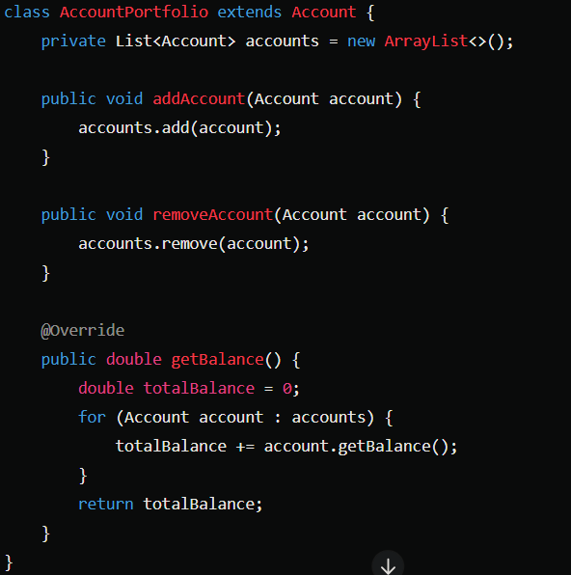
33

Slide 35
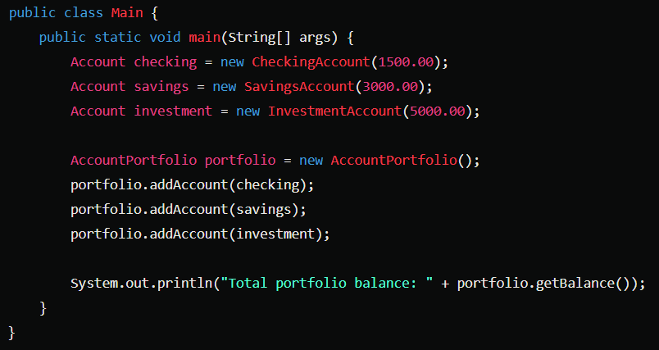
38

Slide 36
FACADE
35

Slide 37
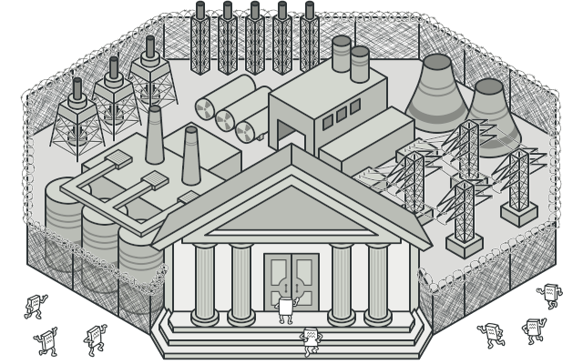
Provides a simplified interface to a complex subsystem
It acts as a front door and hides the complexity of the subsystem and provides a unified interface to interact with it
36

Slide 38
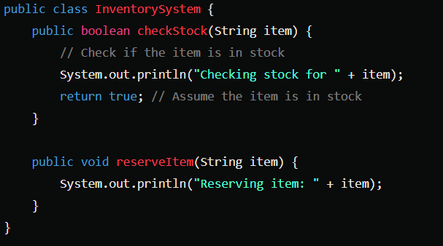
This code is a toy example for an online shopping system. It composes all the complex subsystem into a basic interface.
37

Slide 39
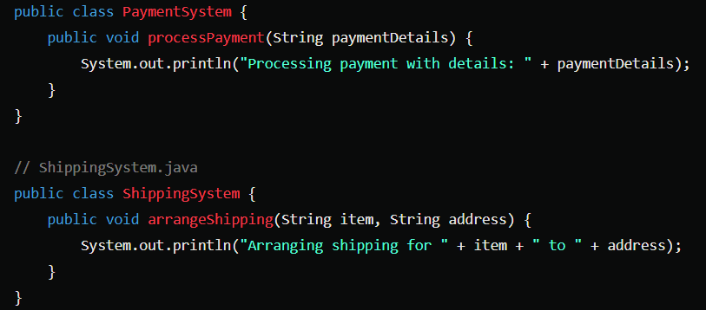
38

Slide 40
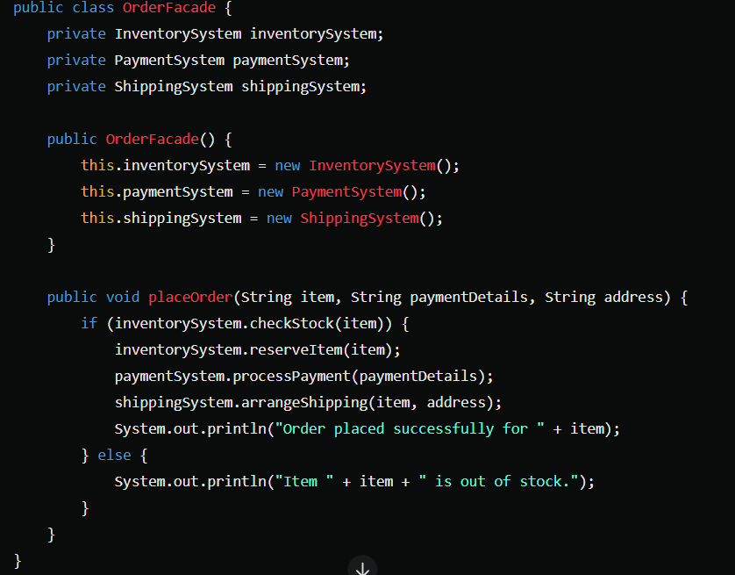
39

Slide 41
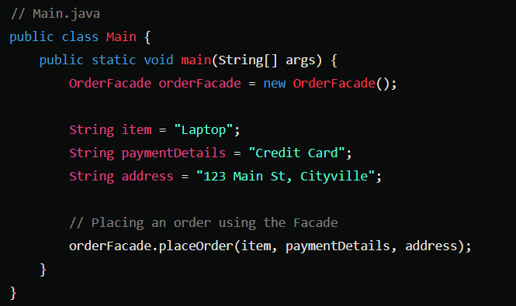
40

Slide 42
PROXY
41

Slide 43
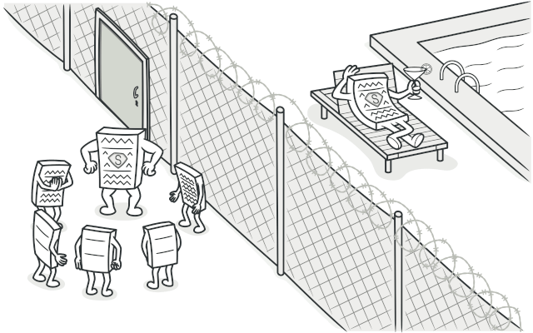
The Proxy Pattern is used to control access to an object
A proxy controls access to the original object, allowing you to perform something either before or after the request gets through to the original object
42

Slide 44

A common example is a virtual proxy for loading images on a web page. The proxy loads the real image only when it’s requested by the user, saving bandwidth and resources
43

Slide 45
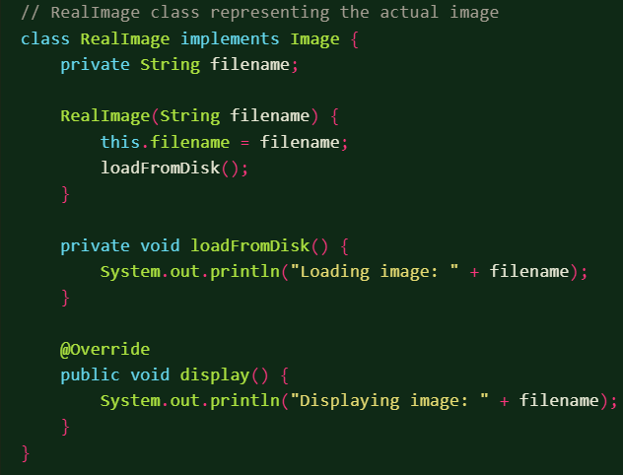
44

Slide 46
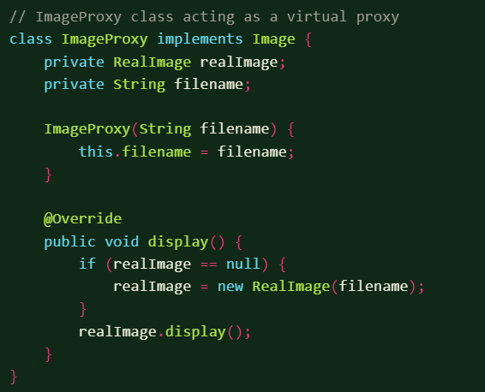
45

Slide 47
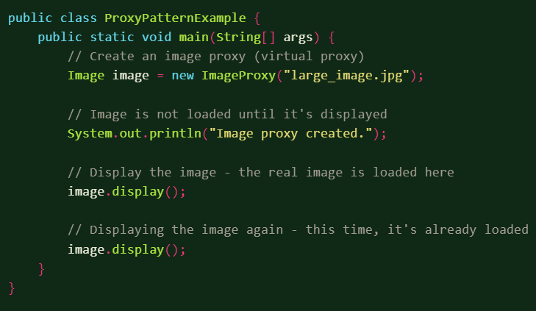
46

Slide 48
REFERENCES
Gang of Four - Design Patterns, Elements of Reusable Object Oriented Software
01
02
https://refactoring.guru/design-patterns/structural-patterns
https://www.initgrep.com/posts/design-patterns/structural-design-patterns-java
03
04
https://medium.com/javarevisited/top-structural-design-patterns-with-real-examples-in-java-7eede31bde45
47

Slide 49
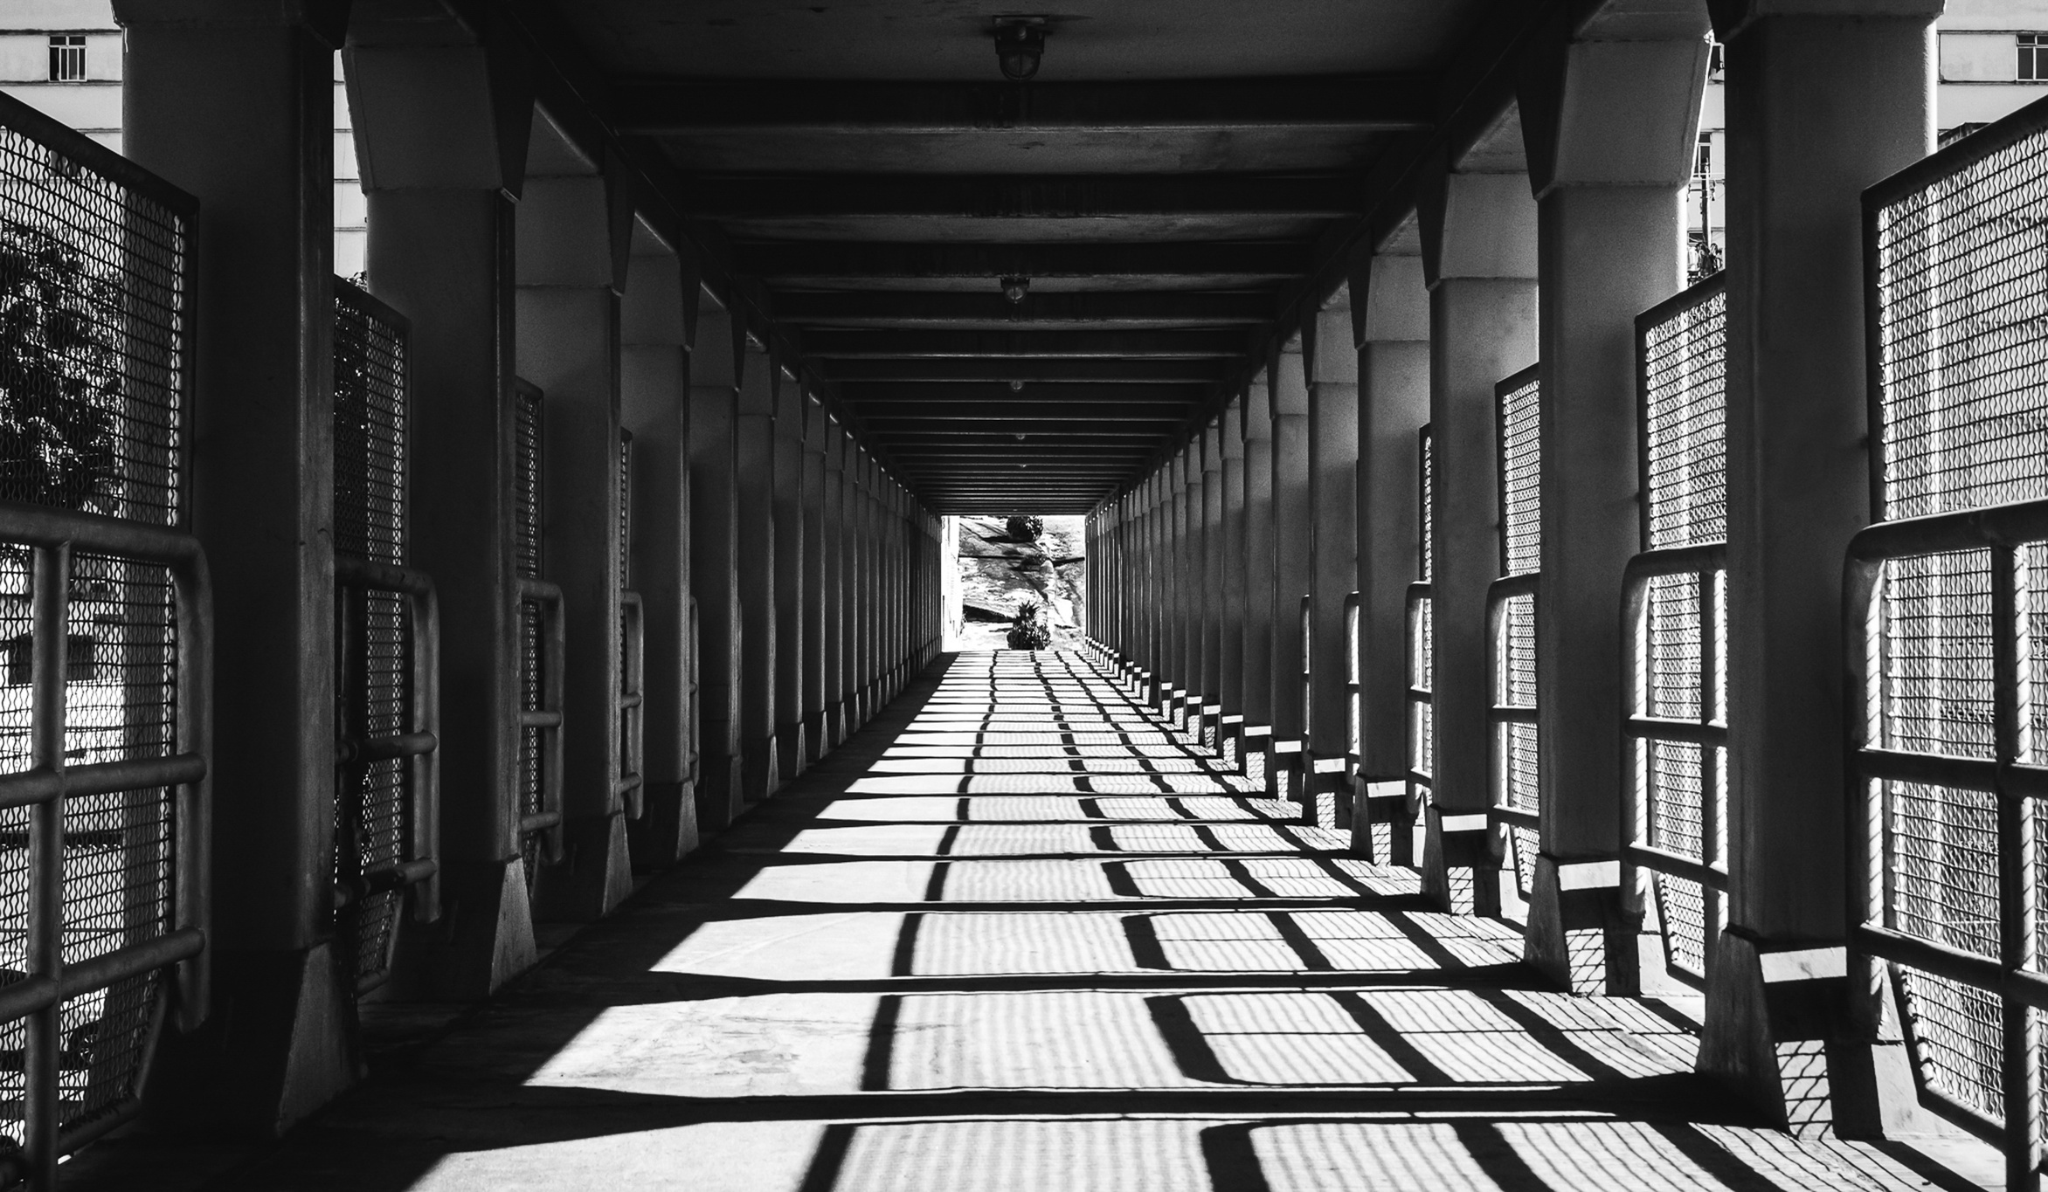


THANK
YOU FOR LISTENNING
https://www.linkedin.com/in/burak-atalay-/
https://github.com/burakataly

